Slide 1
Foundations Of Data Access
Internal Use - Confidential

Slide 2
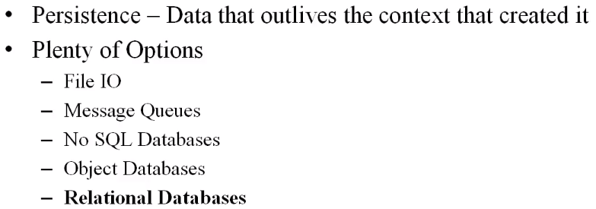
Foundation of Data Access Overview

Slide 3
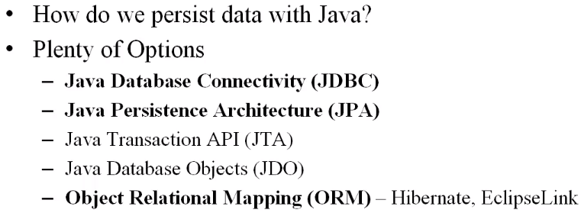
Notes:
With JTA we can persist data into multiple DB at same time.

Slide 4
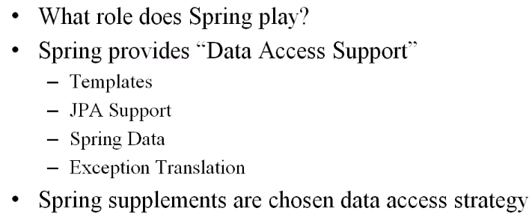

Slide 5
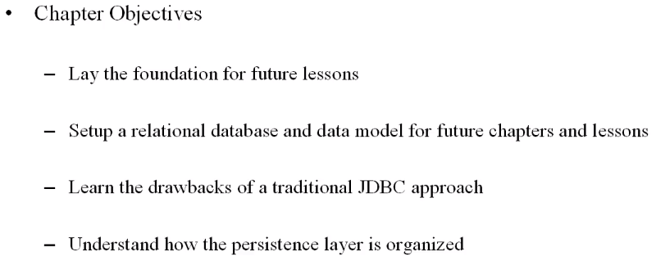

Slide 6
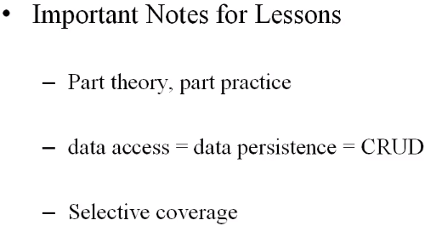

Slide 7
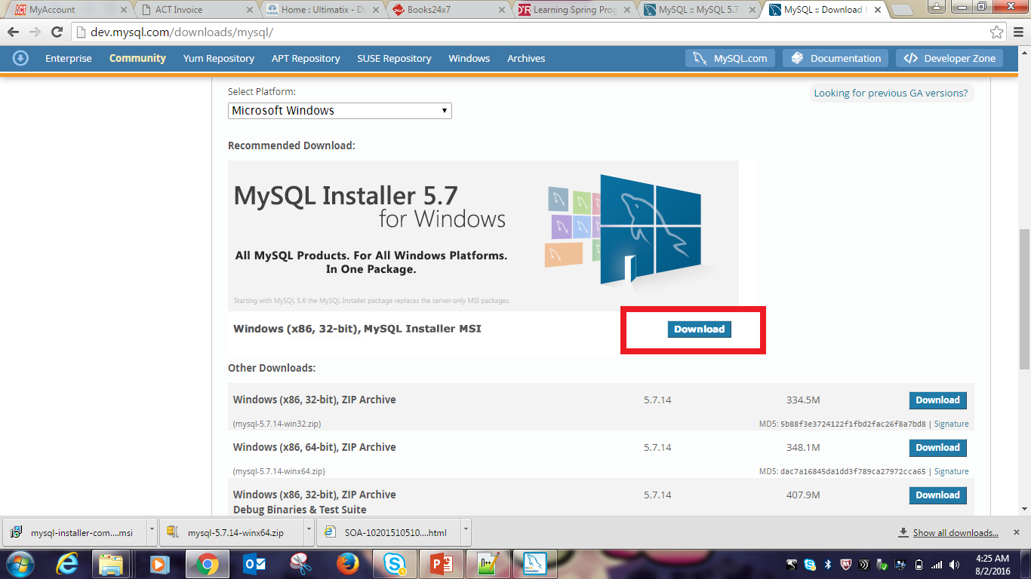
MySQL Installation Setup(MySQL.pptx)
http://dev.mysql.com/downloads/mysql/

Slide 8
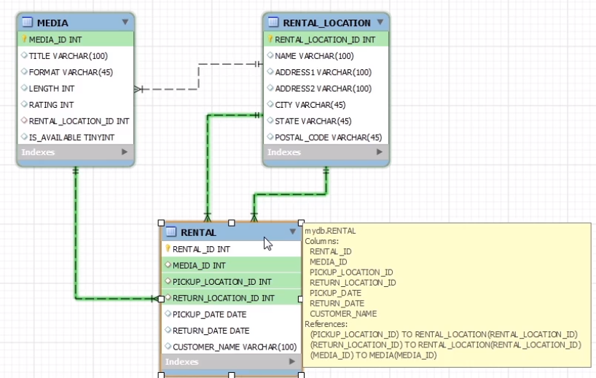
Data Model and Object Model

Slide 9
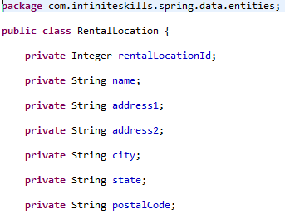
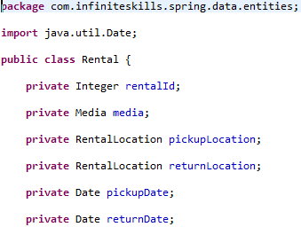
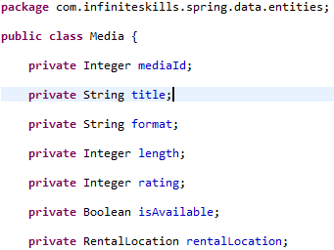
Object Model

Slide 10
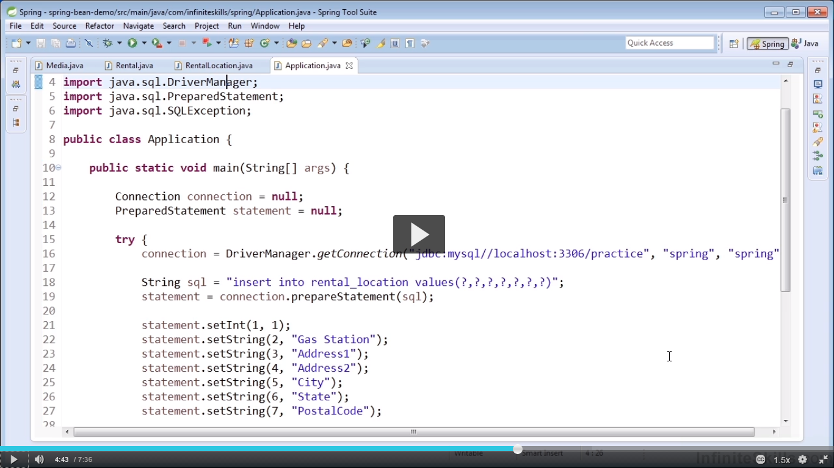
Benefits of Spring Data Support

Slide 11
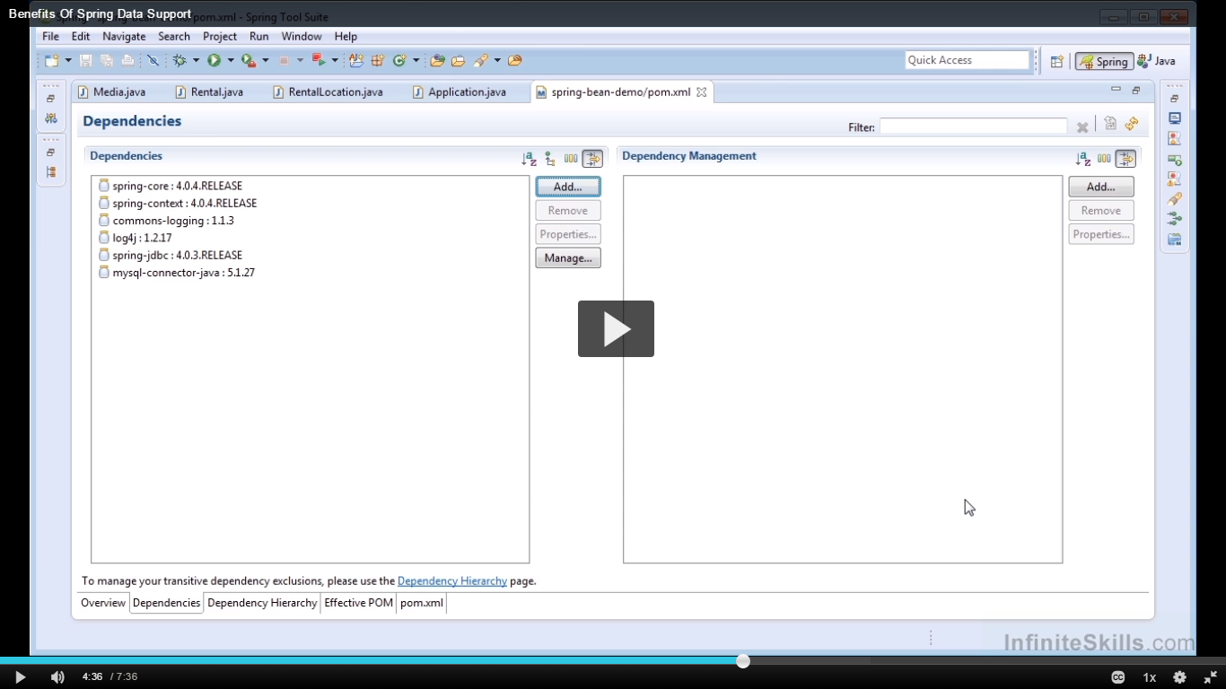
Dependencies need to run this application.

Slide 12
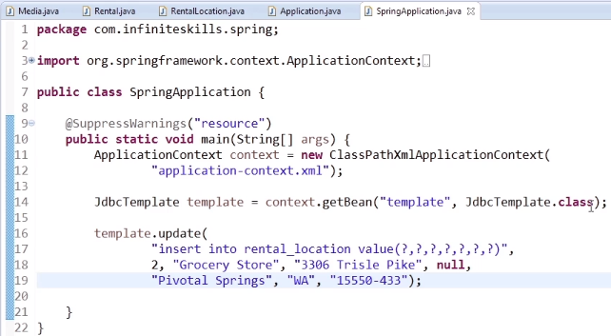
Notes:
It is lot less verbose, Converts the checked exception(SQLException) into runtime exception.

Slide 13
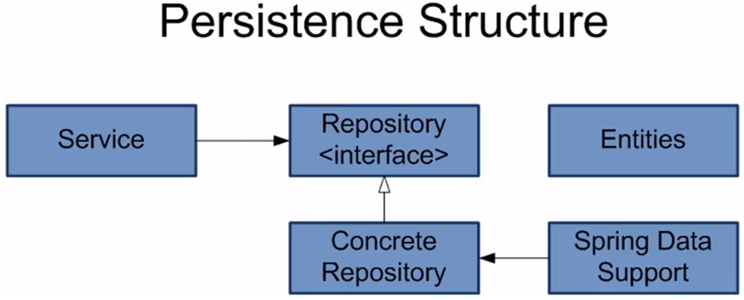
Persistence Layer Structure – Part1
Notes:
Entities : Are Java Object Models for Database tables.
Repository : Is responsible for performing Data Persistence or communication with Data Store.
For example Book Repository Interface.
Concreate Repository : It has several implementation of Repository.
For example in one implementation we have Concrete Repository for storing Book into Database and another implementation for saving to File System.
Spring Data Support : These are the several templates or several mechanisms provided by Spring to Persist our data.
Services : These perform our Business logic, while performing that business logic they will interact with our Repositories.
It has Composition relationship with Repository or Many Repositories.
What is most important is Services will not perform Persist data on it’s own, but it relies upon Repository to perform to persist data.

Slide 14
Entities : Are Java Object Models for Database tables.
Repository : Is responsible for performing Data Persistence or communication with Data Store.
For example Book Repository Interface.
Concreate Repository : It has several implementation of Repository.
For example in one implementation we have Concrete Repository for storing Book into Database and another implementation for saving to File System.
Spring Data Support : These are the several templates or several mechanisms provided by Spring to Persist our data.
Services : These perform our Business logic, while performing that business logic they will interact with our Repositories.
It has Composition relationship with Repository or Many Repositories.
What is most important is Services will not perform Persist data on it’s own, but it relies upon Repository to perform to persist data.

Slide 15
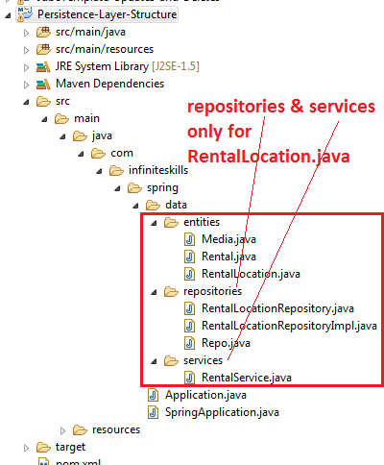
Persistence Layer Structure – Part2

Slide 16
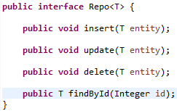
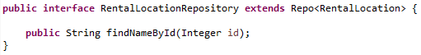
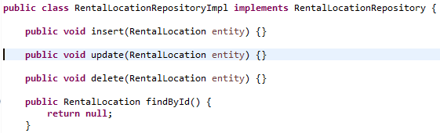
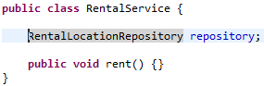

Slide 17
JDBC Template

Slide 18
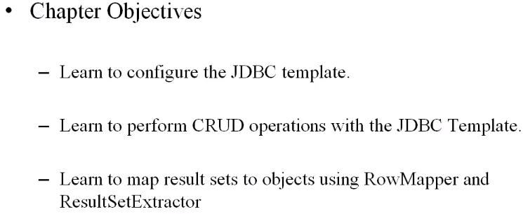

Slide 19
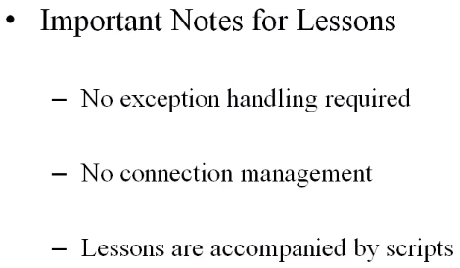

Slide 20
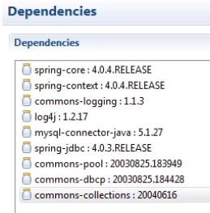
Creating a Data Source
Following dependencies are needed.

Slide 21
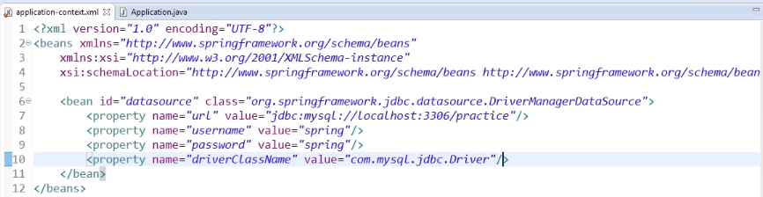
Datasource is configured in Spring IOC as shown below:
But above Data Source is not a pooled data source.

Slide 22
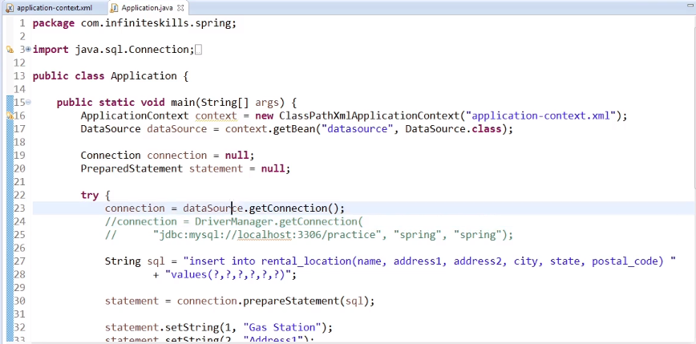
JDBC class is modified as shown below:

Slide 23
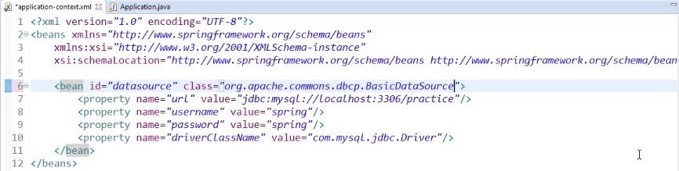
DataSource that is connection pooled can be used in place of earliar datasource.

Slide 24
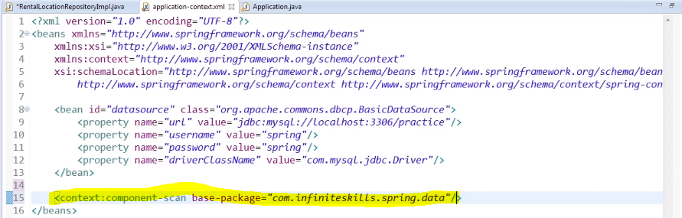
JDBC Template Introduction
Add component scanning in application context.

Slide 25
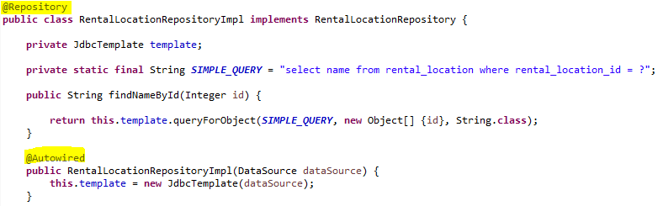
Modifying the class into a Bean to fetch data from DB.

Slide 26
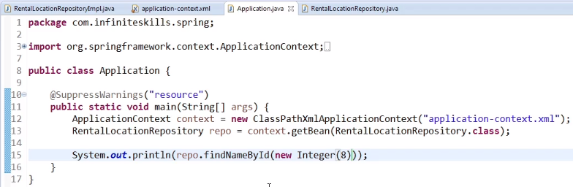
Application will pull-out the record with Id – 8.

Slide 27
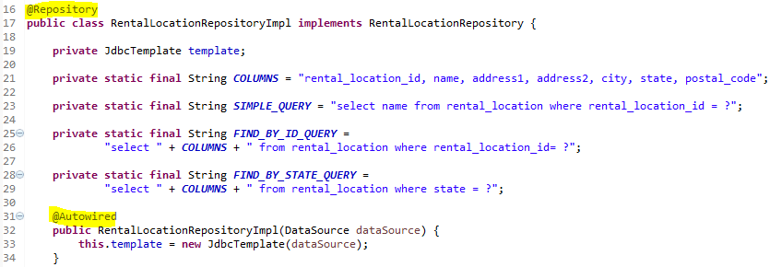
Row Mapper Part - 1
Bean to pull Many columns but one Row using RowMapper and queryForObject method.

Slide 28
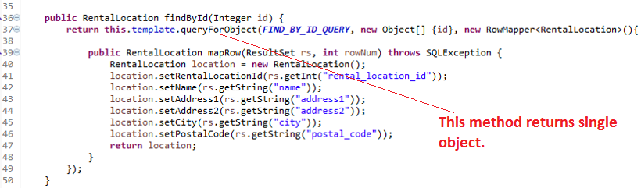
Row Mapper Part – 1(continued..)

Slide 29
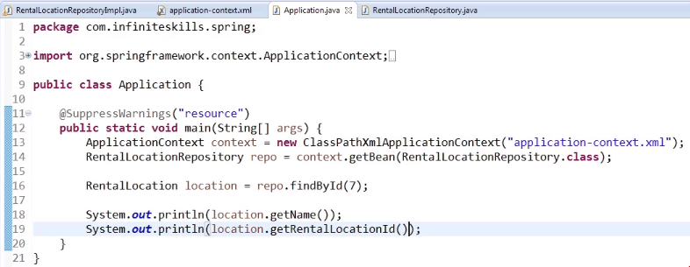

Slide 30
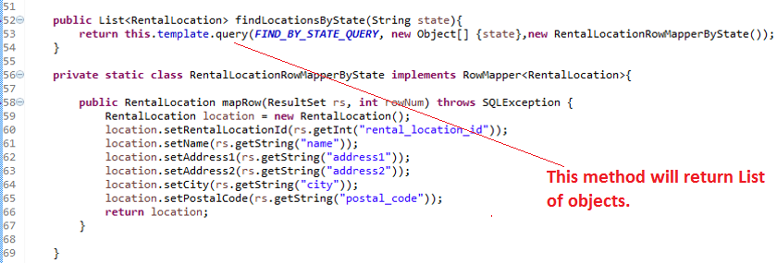
Row Mapper Part - 2
Bean to pull Multiple Columns and Multiple Rows using RowMapper.

Slide 31
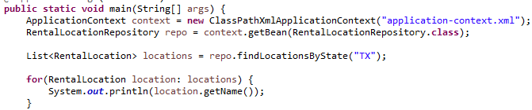

Slide 32
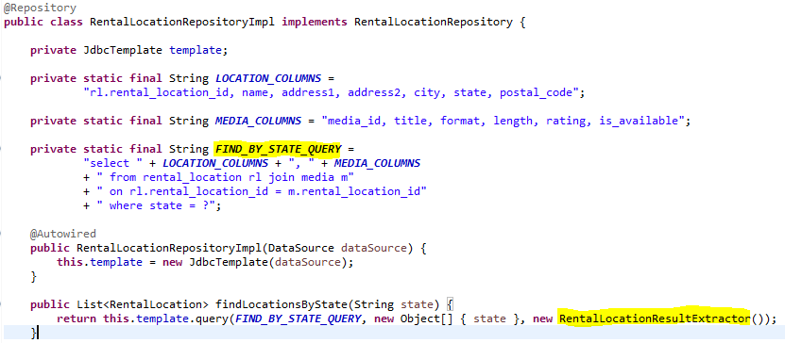
Result Set Extractor
We will use Result Set Extractor to map association between different Entities.

Slide 33
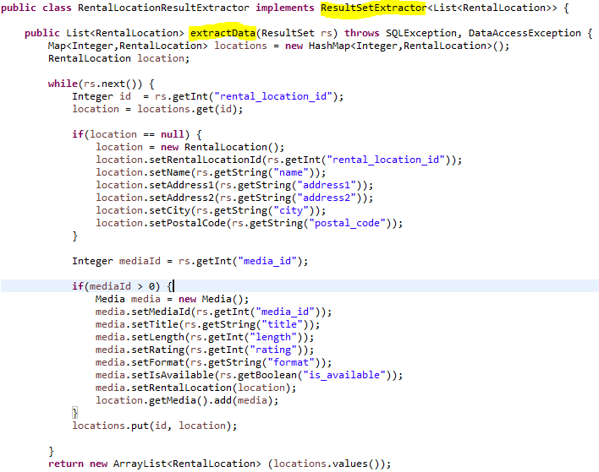

Slide 34
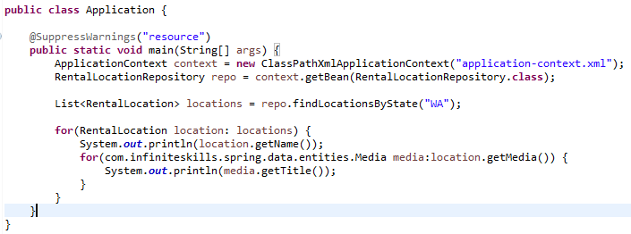

Slide 35
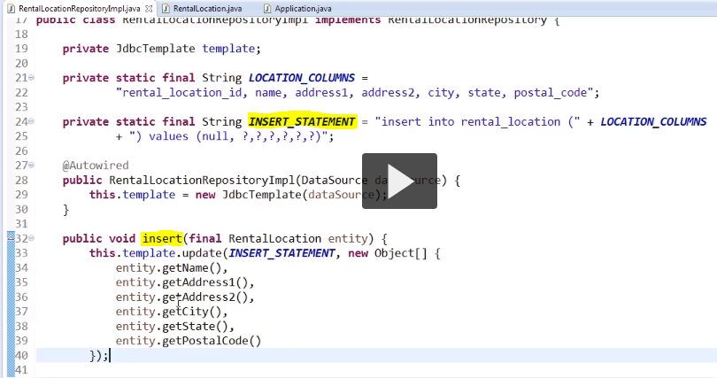
Inserts with JDBC Templates

Slide 36
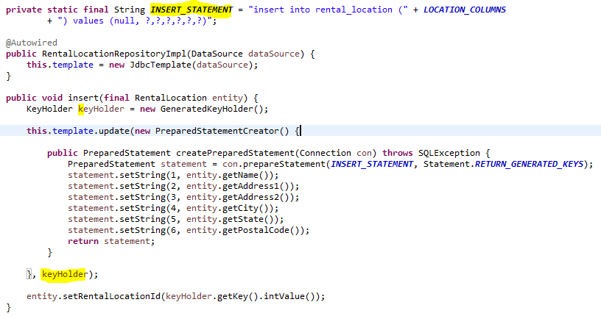
Way to get our Auto Generated ID populated within our Entity.

Slide 37
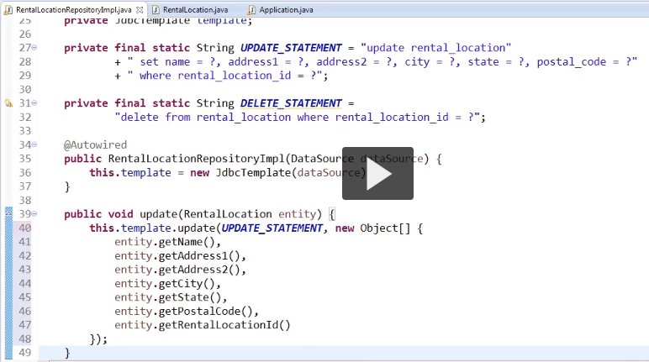
JDBC Templates Update and Delete

Slide 38
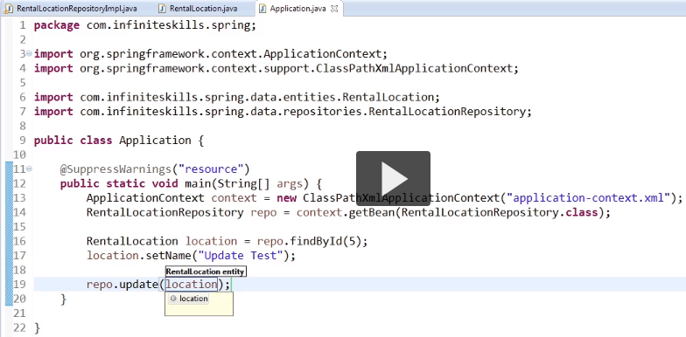

Slide 39
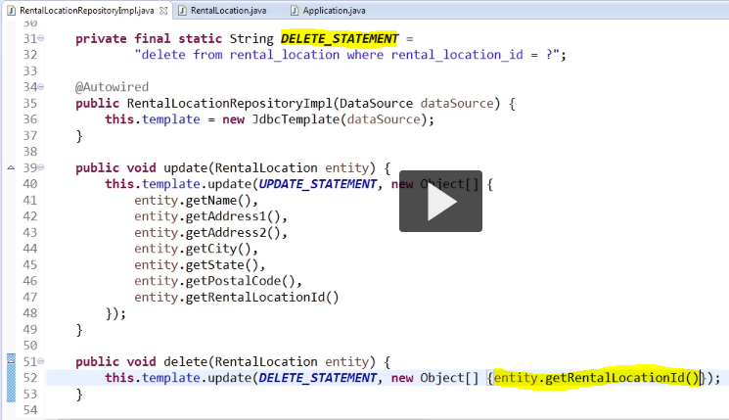

Slide 40
